Slide 1
Data Science Final Project
By:
Eldar Shmueli Netanel Zohar

Slide 2
Let's talk briefly about what the NBA is all about (For those who prefer football) :
The definition according to Wikipedia is:
"The National Basketball Association (NBA) is a professional basketball league in North America".
The league is composed of 30 teams and is one of the major professional sports leagues in the United States and Canada.
It is the premier men's professional basketball league in the world."

Slide 3
The ALL STAR Game
In the NBA league there are special players with extraordinary abilities.
These players are chosen every year by a large number of criteria to be part of the
ALL STARS game, beyond fame and status, the level of extraordinary abilities of the selected
players really caught our attention when we approached to the research question

Slide 4
Formulation of the research question
As the NBA All-Star weekend is getting closer, and the All-Star game as the main event, we wanted to analyze the previous NBA seasons and try to find connection between the regular season statistics to be chosen as an All-Star player.

Slide 5
So , we decided that we wanna be a all star player , what we need to do ?

Slide 6
To answer the previes qeustion and many other , we started collecting all the information that could help us in the research....

Slide 7
Information Gathering Process
Crawling,scraping,selenium
1

Slide 8
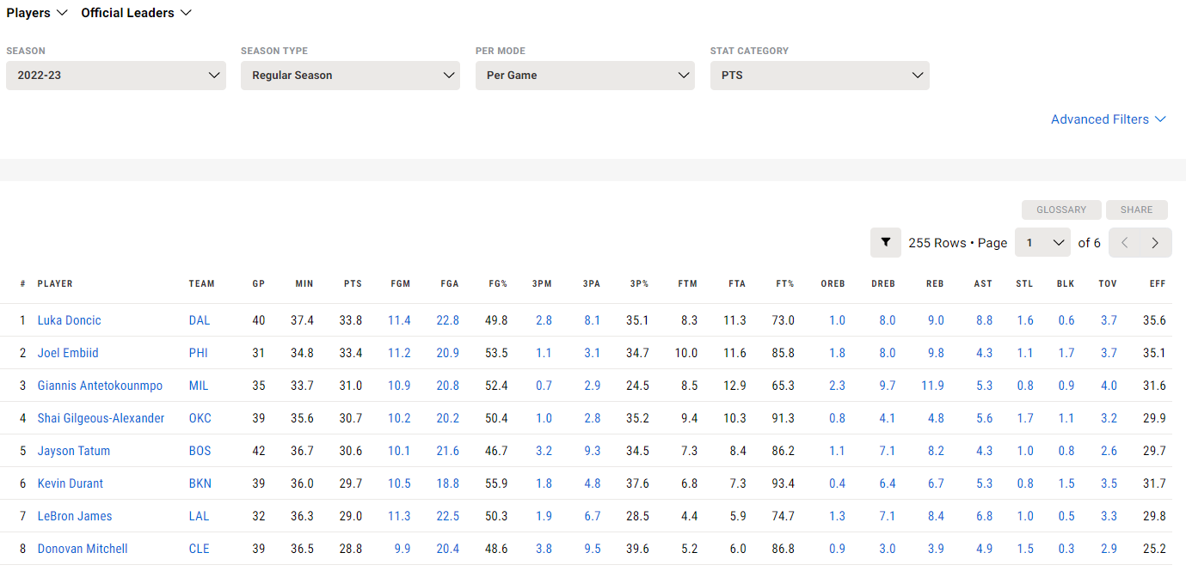
The website we chose to acquire the information is the official website of the NBA
which contains 21 different parameters for each player
In addition, there are players who have a written biography on their page

Slide 9
The first problem we encountered in acquiring the data is the need to switch seasons and acquire all the data from that season
In order to reveal all the information of that season, it is necessary to mark "ALL" here:

Slide 10
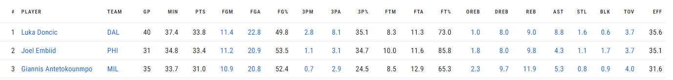
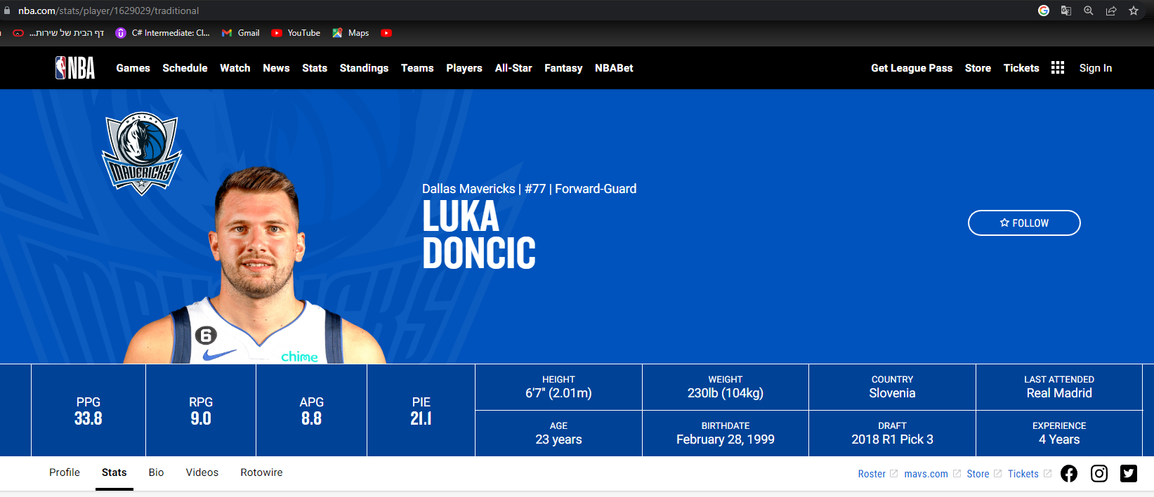
Allso to receive the entire biography on any player, it is necessary to click on the player's name
And another click on BIO

Slide 11
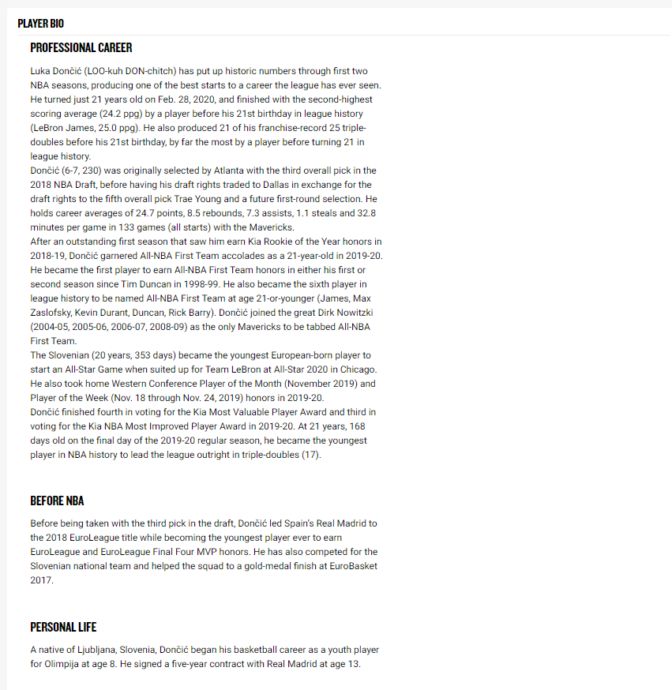
To get the biography we desired

Slide 12
In order to solve the problem, we used the SELENIUM module, which significantly help us in the acquisition of data
After finding a solution to the problem, we were able to acquire the data we wanted, which leads us to the data processing stage

Slide 13
Data Processing
Checking the reliability of the information
2

Slide 14
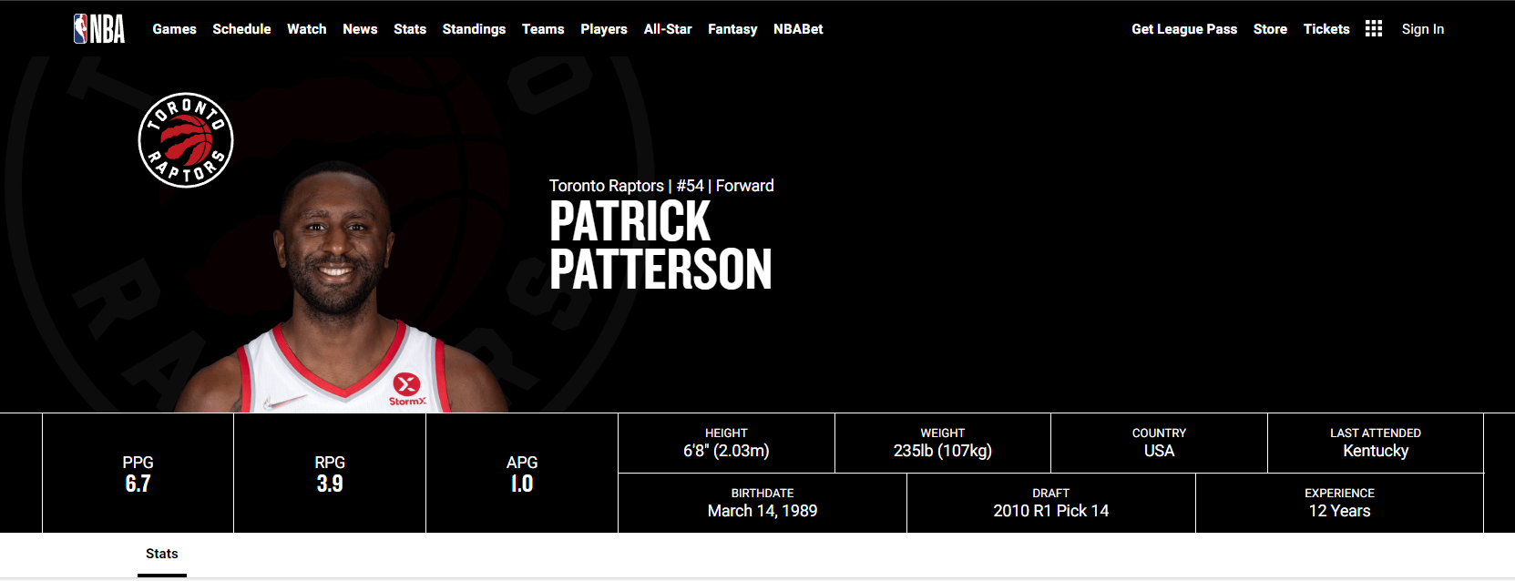
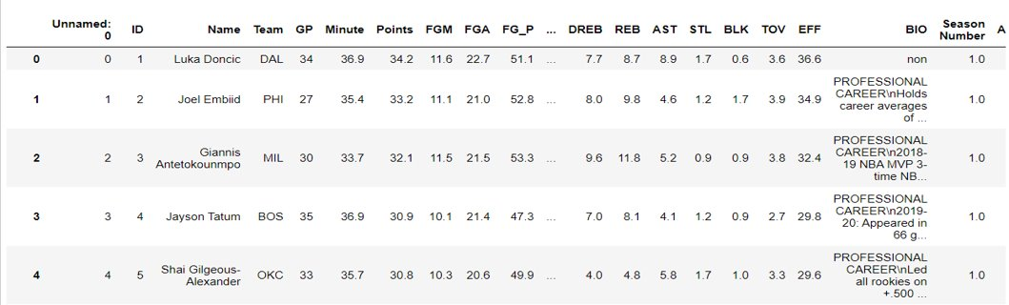
The problems we faced
There are some player without any BIO
When we first looked at the CSV table,we discovered that there are two columns at the beginning of the table without content and use

Slide 15
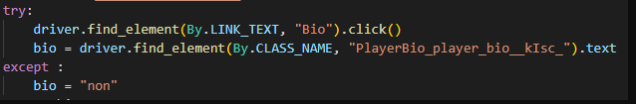
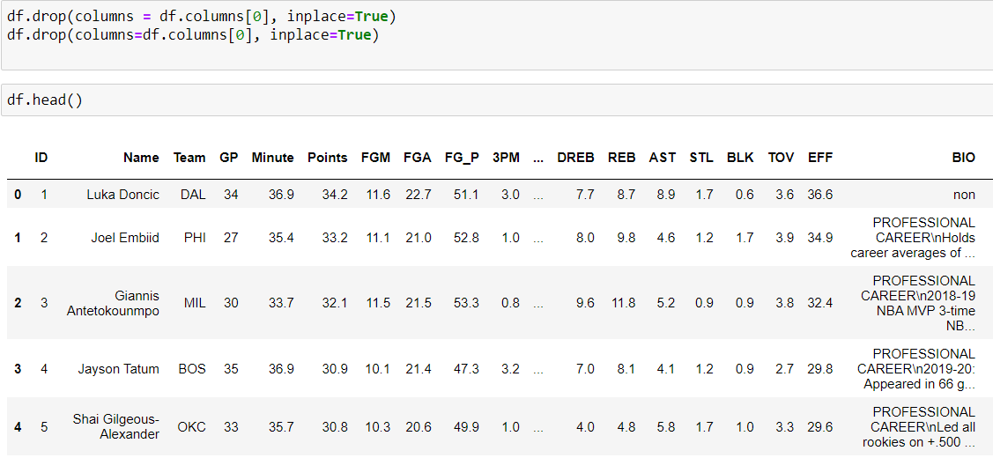
Solution
We have decided for now, any player without a biography will receive a non value
We made calls to the drop() function to omit the unnecessary columns

Slide 16
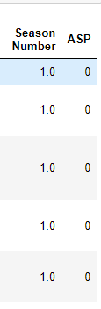
Two additional parameters that we added during the processing of the information: 1. whether the player actually belongs to the ALL STAR : 1-IS ALL STAR , 0-NOT ALL STAR 2. the season number to which the data belongs
We wanted to make sure that it would be easy for us to compare the different players to verify our hypotheses

Slide 17
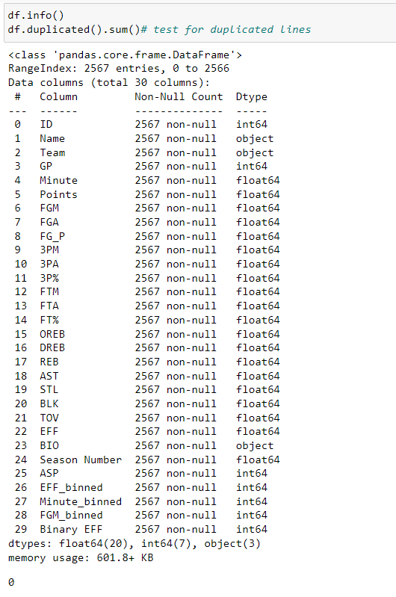
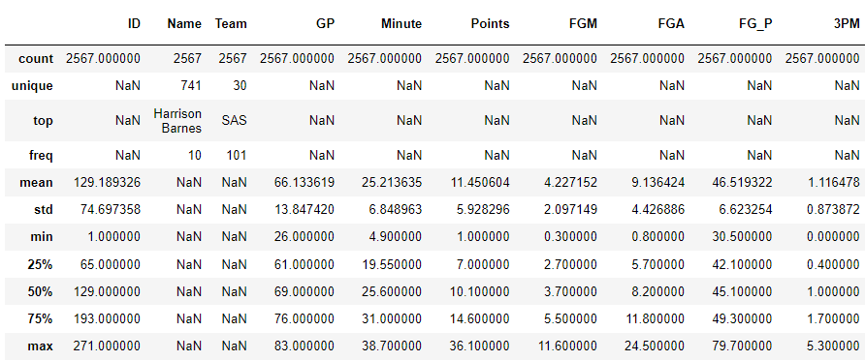
Except for the two problems encountered, all the data came out without any deficiencies, and the value ranges of each data were exactly within the desired range

Slide 18
EDA What does the information tell us?
3

Slide 19
To begin with, we studied the various parameters in depth and tried to cross-reference information to get an overall picture of the ratio between the better players and the less good ones.
In addition, we marked for ourselves some parameters on which we would like to focus :
Points
Field Goals Made
Efficiency

Slide 20
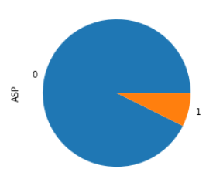
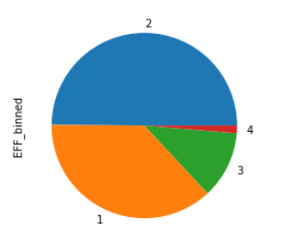
We divided the number of minutes and the level of efficiency into 4 classes of equivalence for easier visualization and crossed different parameters:
ALL STAR In Orange
Efficiency Divided Into 4 Classes

Slide 21
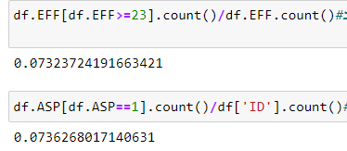
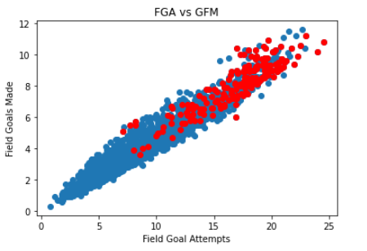
The ALL STAR Players Are Colored Red
It is interesting to see that the probability of being at a high efficiency level or equal to 23 is the same as the probability of receiving an ALL STAR player

Slide 22
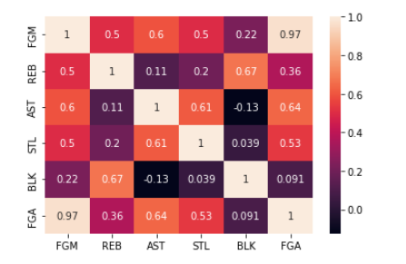
Heat map when different performance parameters are crossed

Slide 23
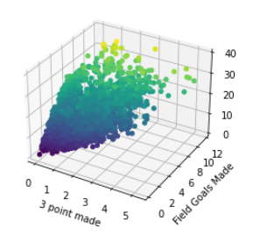
The closer the point is to yellow, the higher the efficiency according to the parameters given in the X and Y axes

Slide 24
So we were able to get a feeling that indeed the parameters we took can indicate whether a player is indeed an ALL STAR
It's time for machine learning....

Slide 25
Machine Learning
Analyzing the information by training models and checking their accuracy
4

Slide 26
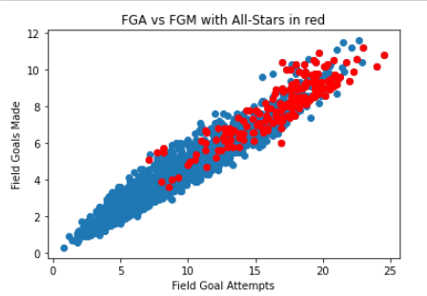
Linear Regression - ML
After the EDA part, we wanted to prove the intended connections. The first module we execute was the Linear Regression module with two features: FGA – Field Goals Attempts and FGM – Field Goals Made.
This Module was important because in the EDA section we clearly see that All-Star players consistently manage to attempts more field goals and also made more field goals and so we wanted to prove this linear module.

Slide 27
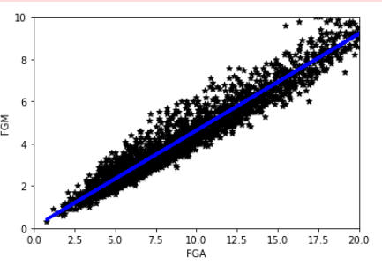
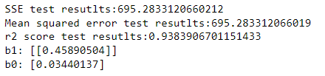
Linear Regression - Results
Linear Regression Module The connection is clear

Slide 28
Linear Regression – Part 2
In the next module we wanted to combine a few modules to one.
We created 3 linear modules for Assist vs Minutes, Steals vs Minutes and Blocks vs Minutes. The idea was to check these 3 features pre minutes together because they all consider as side-features and not important one.
These features doesn't draw attention usually, therefore we wanted to give it a chance and find something special

Slide 29
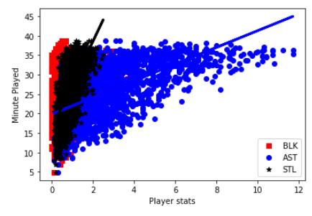
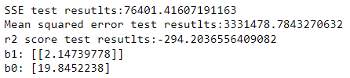
Linear Regression – Part 2 Results
As we can see from the graph and the numbers, we didn't manage to find connection between the 3 features

Slide 30
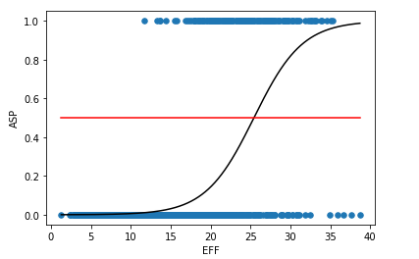
Logistic Regression
Our next module is the logistic regression module between the features: Efficiency to All-Star player. We wanted to check for connections between the efficiency rate to be chosen as All-Star player.
From the graph we can see that
There is a connection between the
Two and we proved it with numbers.

Slide 31



Logistic Regression
First, we set the expit test: If my EFF is 25 points, what is the likelihood that I'll be all star player? Tha value that pulled – 0.464 sent to the IRM test and we can see that it calculate the probabilities correctly
Second, We printed the Confusion Matrix and its accuracy and precision and, in that case, as well it manage to predict well,

Slide 32
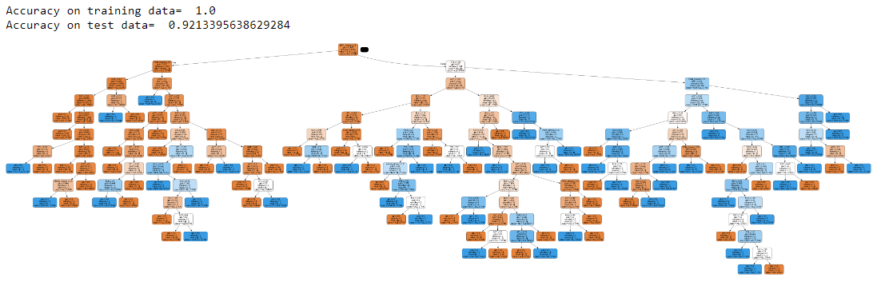
Decision Tree
After we showed the connections between features to All-Star selection, we wanted to sum it up to decision tree
For start we set the tree with the features: EFF-binned, Minute-binned, FGM-binned, Steal, Block, Assist. We got the next tree. As we can see it is pretty accurate but still very big and not easy to understand, therefore we run few modules from the course lessons to get the best depth and the best splits values.

Slide 33
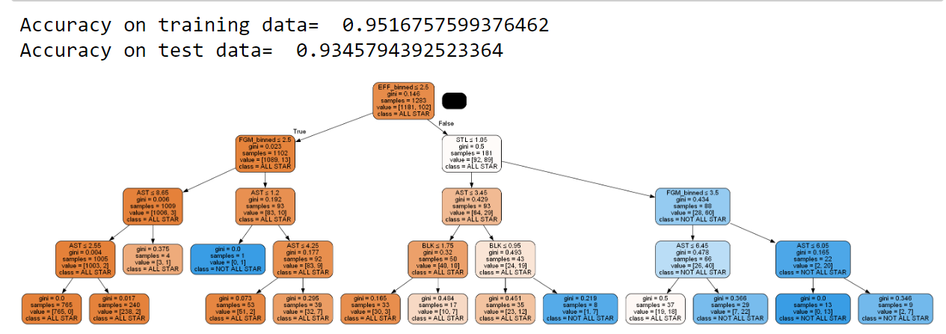
Decision Tree
After we manage to pull the best depth and splits values we set a new tree, which is easier to read and understand.

Slide 34
Text Analyze
As we finished the Regression ML we can start the final part – Text Analyze.
In this part we wanted to find connections between the text that showed in player's Bio. We wondered if the All-Stars players bio have some unique words, then the other players bio.
We used Count Vectorize and WordCloud algorithms for this section.

Slide 35
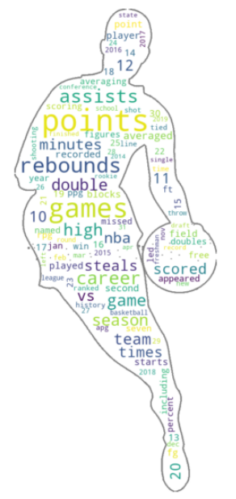
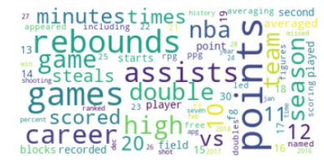
Text Analyze – Word Map

Slide 36
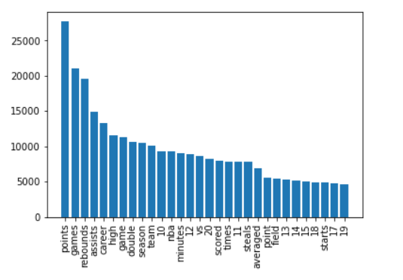
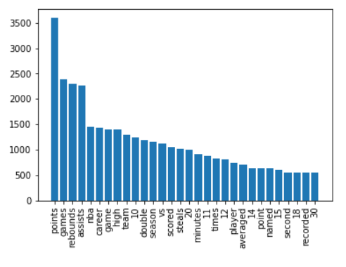
Text Analyze Results
As we can see there is no difference between the All-Star players bio's to all bio's.
We can see clearly that the words incidence are exactly the same between the two.
All bio's top words All-Star players bio's

Slide 37
Our thoughts about the results
Some of our modules shows the exact connection that we looked for – some of the personal statistics from a regular season led to be chosen as an All-Star player
The text analyze conclude with a disappointment and we didn't manage to find connection between the two features
Statistically, the All-Star players selected by the most efficient players in the league

